Slide 1
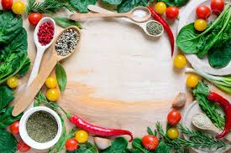

What’s cooking?
:Presented by
Pauline Gerritsen
Shubhada Gopale
Stanislav Ivashkevich
Sumithra Hariguruprasad

Slide 2
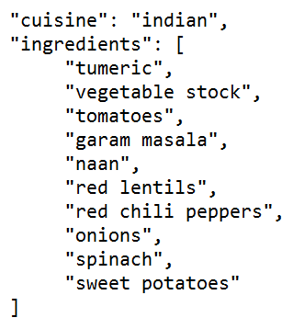
Introduction to Kaggle Dataset
Objective of Kaggle’s What’s Cooking competition is to predict the category of a dish's cuisine given a list of its ingredients.
Train data contains a list of 39774 recipe id’s along with their ingredients and cuisine.
20 cuisines and 6714 ingredients.

Slide 3

Data Exploration

Slide 4
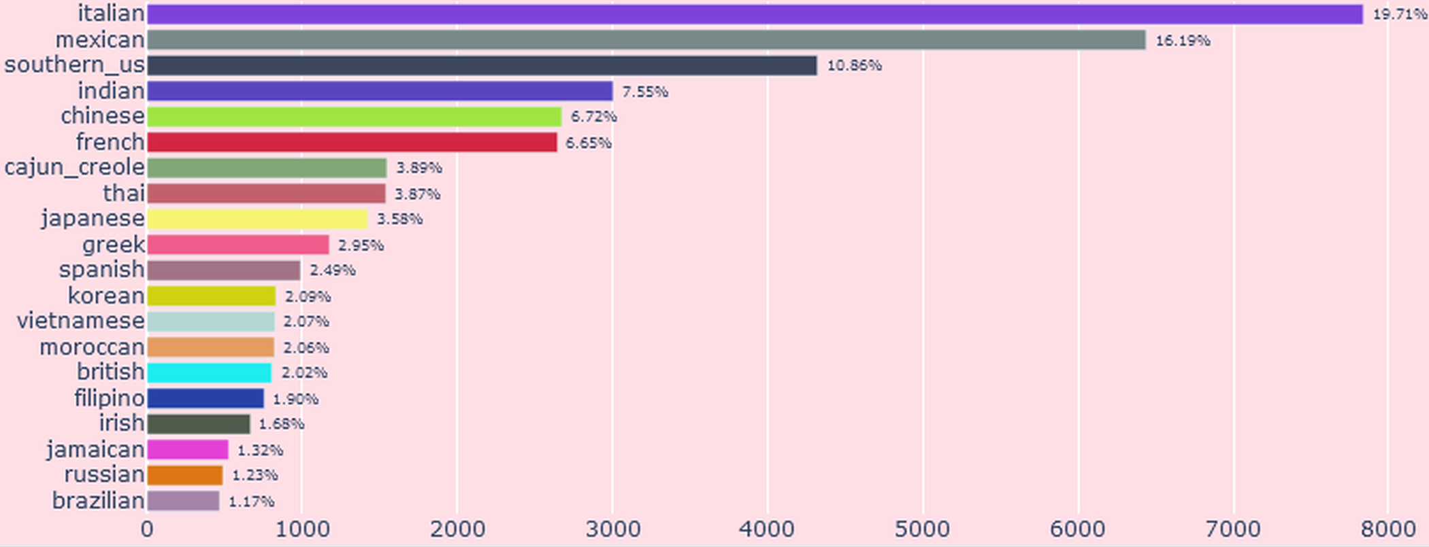
There are 20 cuisines with Italian, Mexican and Southern US make up over 45% of the recipes.

Slide 5
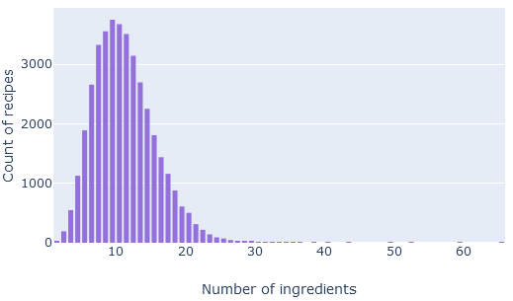
Recipe distribution
The max number of ingredients is 65 and there is only one recipe.
The minimum number of ingredients is 1 and there are 22 recipes which has just 1 ingredient
The mean ingredients is 11.

Slide 6
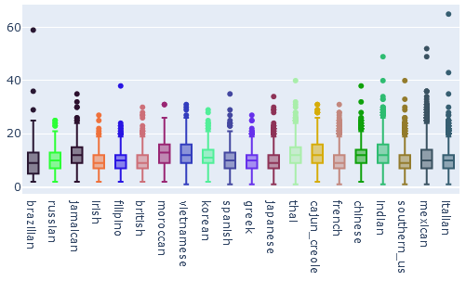
Recipe length distribution by Cuisine

Slide 7
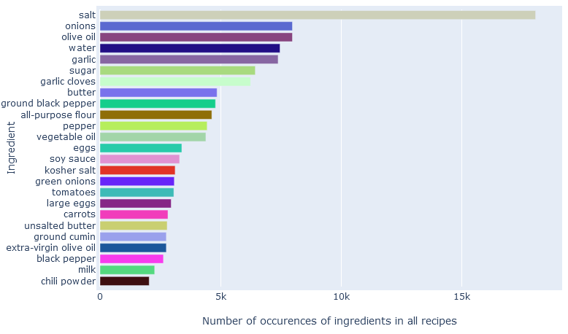
DATA EXPLORATION: TOP INGREDIENTS

Slide 8
Unique Ingredients / Cuisine
Mexican cuisine jalapeno, avocado, salsa, tortillas
Indian cuisine garam masala, turmeric, green chillies
Greek cuisine Feta cheese, red wine vinegar, oregano
Chinese cuisine soy sauce, oyster sauce, peanut oil, hoisin sauce
Jamaican cuisine allspice, thyme, nutmeg
Cajun-creole cuisine cajun seasoning, creole seasoning, andouille sausage
Japanese cuisine mirin, sake, dashi, nori
Korean cuisine soy sauce, sesame oil, Gochujang base, kimchi
Moroccan cuisine chickpeas, couscous
Thai, Vietnamese, Filipino cuisine have similar ingredients - fish sauce, soy sauce, vinegar with few different like coconut milk, lemongrass etc
British, Irish, Russian, Southern_US, French do not have any ingredients only unique to them. So it might be difficult to classify them correctly.

Slide 9
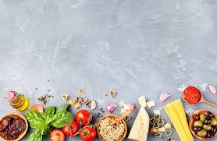
Data Preprocessing
Removal of numbers, special characters, uppercase
Stemming – Find the root of each word using Porter’s algorithm
StopWord Removal – Customized to remove non relevant words like units, sizes, fat free, natural, homestyle etc.
Tokenization - giving an integer id for each possible token/word using CountVectorizer
Countvectorizer Counting the occurrences of tokens in each recipe.
TfidfVectorizer Normalizes and weighs with diminishing importance tokens that occur in the majority of recipes .
The above steps reduced the number of ingredients from 6714 to 2292 .

Slide 10

Modelling Approach
Pipeline
Gridsearchcv
Cross Validation
SMOTE
Dimensionality Reduction
Classifier | Train Accuracy | Test Accuracy
Logistic | 0.861 | 0.785
Multinomial NB | 0.787 | 0.731
LinearSVC | 0.86 | 0.783
RandomForest | 0.738 | 0.644
Voting Classifier | 0.853 | 0.783

Slide 11
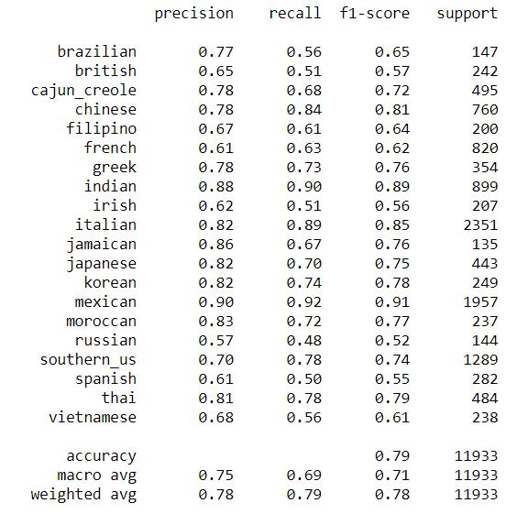
More Metrics
Classification report for Logistic
The Precision is best for Mexican, Indian, Jamaican, Italian, Japanese, Korean, Moroccan, Thai, Chinese, Cajun.
Not so good for Russian, British, French, Spanish

Slide 12
Kaggle Results
1387 teams participated in the competition
Top classification accuracy: 0.83216
Baseline (every predicted cuisine is Italian): 0.19267
51 teams never surpassed the baseline
Our Results
Best Model : Logistic Regression
Accuracy : i0.785

Slide 13
Improvements:
More data for minority classes.
Better stemming techniques.
Get more info for cuisines not having any unique ingredients.
Deep Learning Techniques might help.
Next Steps:
We can reverse the problem: given a cuisine, generate ingredients for a recipe belonging to the cuisine.
Another option: given a recipe, improve it to make it more suitable for a cuisine.

Slide 14
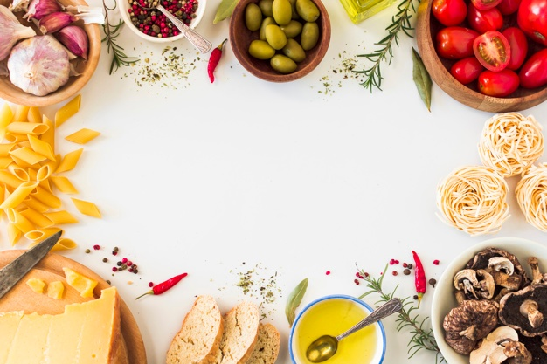
Thank you

